Slide 1
Selenium WebDriver

Slide 2
Version Control and Revision History
 | Name | Date
Prepared By | Karthika | 02-12-2019
Reviewed By
Approved By
Version No. | Date | Affected Sections | Highlights
 |  | ALL | Updated Based on the course sheet coverage

Slide 3








Iconic Representations.......
Test your Memory
Objective
Coffee Break
Can you Solve?
Queries
Recap
Need more Info
Brainstorm

Slide 4
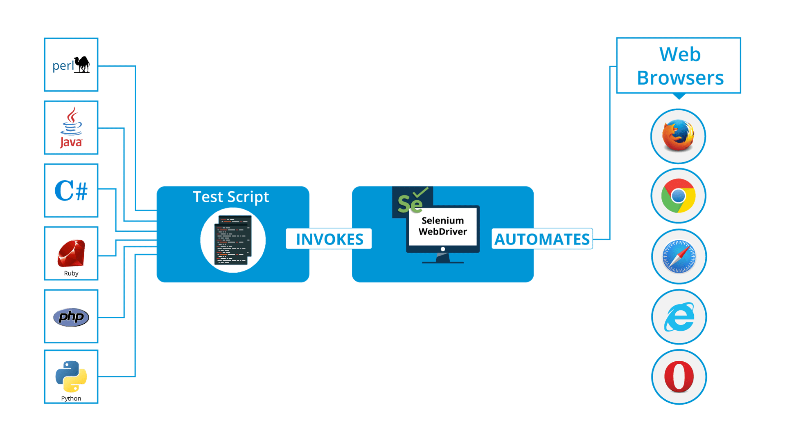
Selenium WebDriver

Slide 5
First Selenium WebDriver Script
To get started, you need to import following two packages:
org.openqa.selenium.*
contains the WebDriver class needed to instantiate a new browser loaded with a specific driver
org.openqa.selenium.firefox.FirefoxDriver (if firefox is used)
contains the FirefoxDriver class needed to instantiate a Firefox-specific driver onto the browser instantiated by the WebDriver class
Notes:
Example:
import org.openqa.selenium.firefox.FirefoxDriver;
public class Demo1 {
public static void main(String[] args) {
FirefoxDriver driver =new FirefoxDriver();
driver.manage().window().maximize();
driver.get("https:\\syntelligence.syntelinc.com");
System.out.println("current URL: "+driver.getCurrentUrl());
driver.close();
}

Slide 6
Exercise :
Launch a new Firefox browser.
Open https:\\syntelligence.syntelinc.com
Get Page Title name and Title length
Print Page Title and Title length on the Eclipse Console.
Get Page URL and verify if the it is a correct page opened
Get Page Source (HTML Source code) and Page Source length
Print Page Length on Eclipse Console.
Close the Browser.

Slide 7
WebDriver API Commands and Operations
Select : Using this we can deal with objects having Select tag
Syntax :
WebElement select = driver.findElement(By.tagName( "select" ));
List<WebElement> allOptions = select.findElements(By.xpath("//select[@id='s_provider'][//li[2]/select]" ));
for (WebElement option : allOptions) {
System.out.println(String.format( "Value is: %s"option.findElements(By.tagName("option" ))));}

Slide 8
Moving Between Windows and Frames
Some web applications have many frames or multiple windows. WebDriver supports moving between named windows using the “switchTo” method.
Syntax:
driver.switchTo().window( "windowName" );
driver.switchTo().frame( “frameName" );

Slide 9
WebDriver API Commands and Operations
Browser Navigation
Syntax :
driver.navigate().to( "http://www.example.com" );
“navigate” interface also exposes the ability to move backwards and forwards in your browser’s and refresh the current page
Syntax :
driver.navigate().forward();
driver.navigate().back();
driver.navigate().refresh();

Slide 10
WebElement
WebElement represents an HTML element.
Syntax-
WebElement object write the below statement:
WebElement element = driver.findElement(By.id(“UserName“));
Actions which can be performed on a WebElement object.
Clear Command
clear( ) : void – If this element is a text entry element, this will clear the value. This method accepts nothing as a parameter and returns nothing.
Notes:
Command – element.clear();
WebElement element = driver.findElement(By.id("UserName"));
element.clear();

Slide 11
WebElement, findElement(), findElements()
There are various techniques by which the WebDriver identifies the form elements based on the different properties of the Web elements like-
By ID
By Name
By Link Text
By CSS
By Xpath
Web Driver provides the following two methods to find the elements-
findElement() – finds a single web element and returns as a WebElement object.
findElements() – returns a list of WebElement objects matching the locator criteria.
Notes:
WebDriver driver;
System.setProperty("webdriver.chrome.driver", "D:\\Softwares\\chromedriver_win32\\chromedriver.exe");
driver = new ChromeDriver();
driver.get(“https://webapp2.syntelinc.com/owa");
WebElement l=driver.findElement(By.partialLinkText("Log"));
l.click();
driver.findElement(By.name("uname")).sendKeys(“SD564789");
driver.findElement(By.name("pwd")).sendKeys("Syntel123$");
driver.findElement(By.name("btnSbt")).click();

Slide 12
Exercise :
1) Automate the scenario of Viewing attendance of current month in syntelligence. Use properties : ID, Name, Class Name, Link Text, CSS, Xpath

Slide 13
Exercise:
1)Automate the scenario of Filling timesheets in PS finance. Illustrate the use of switchTo() for frames and windows.
2)Automate the process of applying for medical reimbursement in PS Finance.

Slide 14
WebDriver API Commands and Operations
Actions Class :
The Action class is user-facing API for emulating complex user actions.
WebDriver users can use this class to simulate usage of keyboard or mouse events.
Some of the actions that can be performed by the Actions class are :
doubleClick
moveToElement
dragAndDrop
clickAndHold
contextClick(right Click)
Syntax :
Actions builder = new Actions(driver);
WebElement tagElement = driver.findElement(By.linkText("CDMA")); builder.moveToElement(tagElement).click().build().perform();

Slide 15
Exercise :
Perform context click, doubleClick, dragAndDrop, clickAndHold, moveToElement using Actions Class of Selenium Webdriver

Slide 16
Working with Xpath & CSS
XPath : Xpath is a query language for selecting nodes and navigating through elements and attributes of an XML document.
Selenium uses xpath to select objects.
Syntax:
driver.findElement(By.xpath("//img[@alt='Editor for Needed By']")).click();
Css :
The CSS locator strategy uses CSS selectors to find the elements in the page
Syntax:
driver.findElement(By.cssSelector("div.btntextdiv.f1")).click();

Slide 17
Handling Unexpected Alerts / Pop-ups
Popup & Alert Dialog Boxes:
Selenium provides us with an interface called Alert. It is present in the org.openqa.selenium.Alert package. Alert interface gives us following methods to deal with the alert:
accept() To accept the alert
dismiss() To dismiss the alert
getText() To get the text of the alert
sendKeys() To write some text to the alert
Syntax :
Alert alert = driver.switchTo().alert();
System.out.println(alert.getText());
assertEquals(alert.getText(), closeAlertAndGetItsText());

Slide 18
Exercise :
Try to automate a scenario which displays an Alert box in myatos-syntel

Slide 19
Implicit, Explicit & Fluent Wait
Implicit wait:
Implicit waits will be in place for the entire time the browser is open.
To start using an implicit wait, you would have to import this package into your code.
Example
Import java.util.concurrent.TimeUnit;
driver.manager().timeouts().implicitlyWait(10,TimeUnit.Seconds);

Slide 20
Explicit Wait
Explicit wait:
Explicit waits are done using the WebDriverWait and ExpectedCondition classes
we can use some of the prebuilt ExpectedConditions to wait for elements to become clickable, visible, invisible, etc.
Notes:
Example
WebDriverWait wait = new WebDriverWait(driver, 10);
WebElement element = wait.until(ExpectedConditions.elementToBeClickable(By

Slide 21
Fluent Wait
Fluent wait:
FluentWait instance defines the maximum amount of time to wait for a condition
the frequency with which to check the condition.
the user may configure the wait to ignore specific types of exceptions whilst waiting, such as NoSuchElementExceptions when searching for an element on the page.
Notes:
// Waiting 30 seconds for an element to be present on the page, checking
// for its presence once every 5 seconds.
Wait wait = new FluentWait(driver)
.withTimeout(30, SECONDS)
.pollingEvery(5, SECONDS)
.ignoring(NoSuchElementException.class);
WebElement foo = wait.until(new Function() {
public WebElement apply(WebDriver driver) {
return driver.findElement(By.id("foo"));
}
});

Slide 22
AutoIT
AutoIt is a free scripting language designed to automate the windows component.
It's just like an extensive VB Script and it allows you to convert the script in executable (exe).
We have to write the script to handle dialog box using AutoIt, convert it into executable and then call the executable when required.
Helps in Handing Modal Dialogs (if it appears, all the focus of that application will be on that dialog box only. It will not allow to access the parent window until its closed.)
Such as : Save As Dialog box

Slide 23
Exercise:
1) Automate a scenario which is having a Windows dialogue box .Try automating a file download scenario from the web.

Slide 24
For more information please contact: T+ 33 1 98765432 F+ 33 1 88888888 M+ 33 6 44445678 firstname.lastname@atos.net

